Slide 1

INDICATORS FOR CIRCULAR ECONOMY
Arnau Gonzalez Juncà PhD

Slide 2
Circular Economy: What is it about?
According with renowned Ellen MacArthur Foundation: “Underpinned by a transition to renewable energy sources, the circular model builds economic, natural, and social capital. It is based on three principles:
Design out waste and pollution
Keep products and materials in use
Regenerate natural systems”
According with the European Parliament:
“The circular economy is a model of production and consumption, which involves sharing, leasing, reusing, repairing, refurbishing and recycling existing materials and products as long as possible. In this way, the life cycle of products is extended.”

Slide 3

HOUSEFUL: 5 Pillars
Holistic
Materials
Water
Waste
Energy
HOUSEFUL is centered on the Building Construction sector and proposes CE-based solutions centered on Materials, Water, Waste and Energy, as well as a couple of holistic solutions

Slide 4
Circularity in the Built Environment
Current approaches of Building Circularity assessment are mainly based only on materials assessment
A building should be environmentally circular, socially sustainable and economically responsible
HOUSEFUL’s Circularity Methodology proposes a holistic approach referring to:
Material resources
Energy
Water
Social issues
Environmental impact
Economic value
HOUSEFUL’s methodology is aligned with Level(s) Framework of Sustainability Indicators for buildings

Slide 5
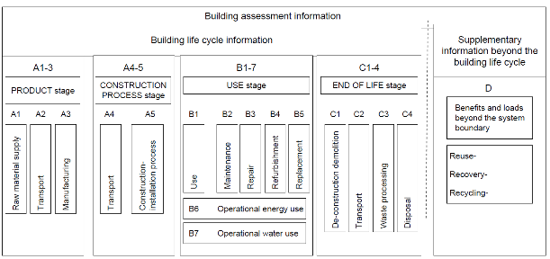
HOUSEFUL’s Building Circularity Methodology Scope
Methodology usable for both new construction and major renovation
Life cycle approach (aligned with EN 15978 - Sustainability of construction works)
Source: Adapted in (Moncaster & Song, 2012) from (CEN, 2011)

Slide 6
Circularity Indicators
Energy: Flow analysis
Embedded energy of products & materials, transportation & construction energy cost, operational energy use and dismantling and residues post-treatment embedded energy
“Circular” Energy: renewable energy produced on-site or nearby
Materials: Flow analysis
Evaluation of circularity in terms of cycled materials use both upstream (products & materials) and downstream (C&DW) and incorporating products and parts service life and associated replacements
“Circular” Materials: see later

Slide 7
Circularity Indicators
Water: Flow analysis
Evaluation of circularity in terms of: water footprint of products & materials, construction water use, operational water use and dismantling and C&DW post-treatment water footprint
“Circular” Water: on-site or nearby cycled water, i.e. recovered greywater, blackwater, rainwater…
Social impact: checklist count
Evaluation of circularity in terms of social added value, also including relevant indicators – aside from Level(s) ones – to express and measure the positive social impact (i.e. Cradle-to-Cradle, LEED, BREEAM…)
Social added value positively computing for Circularity includes Health and Comfort (use stage), Use of local workforce and pollution prevention (construction and deconstruction), social fairness (product stage)

Slide 8
Circularity Indicators
Environmental impact: LCA/LCC
Evaluation of GWP reduction calculated by means of a Life Cycle Assessment (LCA). This is an overarching vector evaluating the environmental benefits of the entire project and therefore incorporating effects from pillars 1 to 4
Environmental impact reduction positively computes for circularity of the building
Economic value: LCA/LCC
Evaluation of Life Cycle Cost reduction calculated by means of a Life Cycle Costing (LCC) analysis. This is an overarching vector evaluating the economic value of the entire project incorporating positive and negative externalities and therefore incorporating effects from pillars 1 to 5
Life Cycle Cost reduction positively computes for circularity of the building

Slide 9
Circularity Indicators

Slide 10
Which pillar is more important?
Depending on the location of the building assessed, one pillar or another might hold more importance than the others
HOUSEFUL approach proposes the use of Eurostat indicators to tackle the different level of stress of the region in one or another aspect
Energy Dependency Rate, Share of RE in Gross Energy Consumption
Water Exploitation Index
Unemployment Rate, Energy Poverty
GHG emissions per capita, % reduction missing to reach 2030 target
GDP per capita, Gini coefficient or Inequality
…
A “Building Circularity Score” is assigned as the weighted average of all pillar circularity scores

Slide 11
Thank you

